Slide 1
NESTLING
SC2006 GROUP 4
Notes:
Sharmilla
Good morning, My team and I are here to present on our Nestling application.

Slide 2
Problem Statement
Ever wondered how property prices work?
What’s the right price for a property?
How to embark on the journey for your dream home?
Notes:
Sharmilla
Yes, there are other property applications such as property Guru and propnex, but the underlying questions that these applications do not provide are how housing prices work, what is the right price for a property and the steps to take when embarking on your dream home.

Slide 3

Target Audience
Prospective Private Home Buyers in Singapore
Notes:
Sharmilla

Slide 4
Agenda
01
02
Nestling
Main Features
& Implementations
03
04
05
Language & APIs
Documentations
Traceability
06
07
Good Practices
Live Demo
Notes:
Sharmilla

Slide 5


Slide 6
What is Nestling?
Predictive Analysis
Estimate Price
Compare Listings
Leveraging historical data and trends to offer for analysis
Estimated property price generation to manage expectations
Ability to compare properties and keep a repository of selected ones
Notes:
Abhijeet What is Nestling?
It is a web application that helps prospective private home buyers or investors to find information on estimated pricing using predictive analysis techniques. Nestling also provides evaluations of their desired housing properties which is generated using artificial intelligence. They also receive up-to-date data on current properties on the market based on their specifications and have the ability to make comparisons between properties.

Slide 7
Main Features
& Implementations
Notes:
Abhijeet
Now we will talk about the main features and implementations.

Slide 8
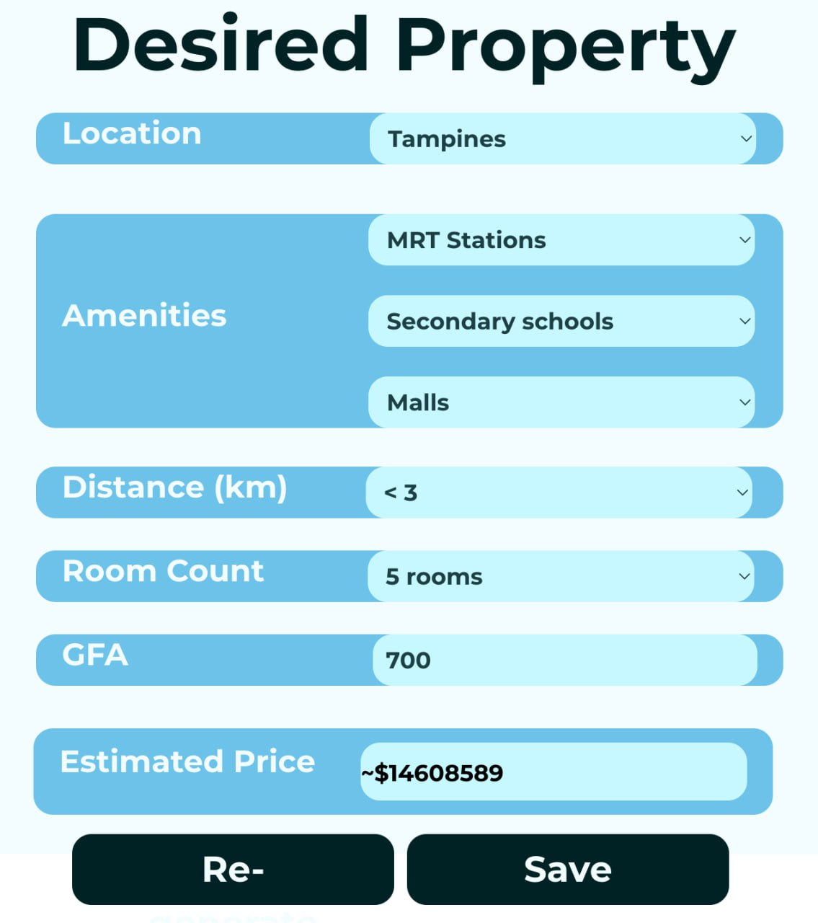
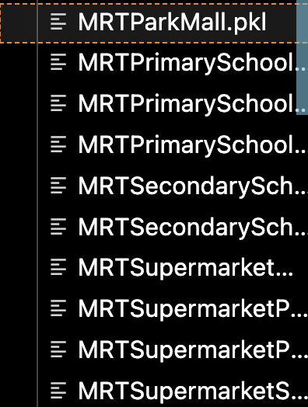
Nestling Main Features
PricePoint AI
Notes:
Abhijeet
One of the key features of Nestling is, PricePoint AI, which uses artificial Intelligence to estimate prices based on their desired property attributes. In order to generate the training and testing data sets, we use data from various APIs and government datasets. We decided to to allow the users to choose 3 out of 6 possible amenities so we had to generate 20 models for each possible combination. The models could be one of the three possible models we have decided to use, namely, Lasso Regularisation, Ridge Regularisation and Decision Tree Regression.
Lasso and Ridge Regularization are techniques used in regression analysis to prevent overfitting by adding penalty terms to the model's objective function, with Lasso imposing a penalty based on the absolute value of the coefficients and Ridge imposing a penalty based on the squared magnitude of the coefficients.
Decision tree regression is a non-parametric supervised learning method that partitions the feature space into hierarchical structures to predict continuous target variables by recursively splitting data based on the most significant feature.

Slide 9
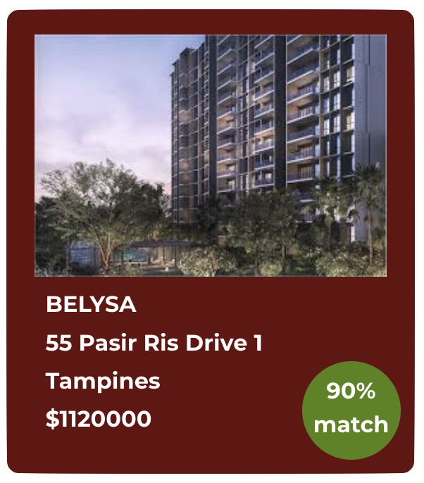
Nestling Main Features
Property Percentage Match
Our application can calculate the best percentage match between buyers’ desired property attributes and current listing attributes.
Notes:
Huai zhi?
Our second feature is percentage match control class. This determines the percentage match between the attributes that the user has specified in the filter, compared to the each of the properties in the database. This is achieved using a point-based system.

Slide 10
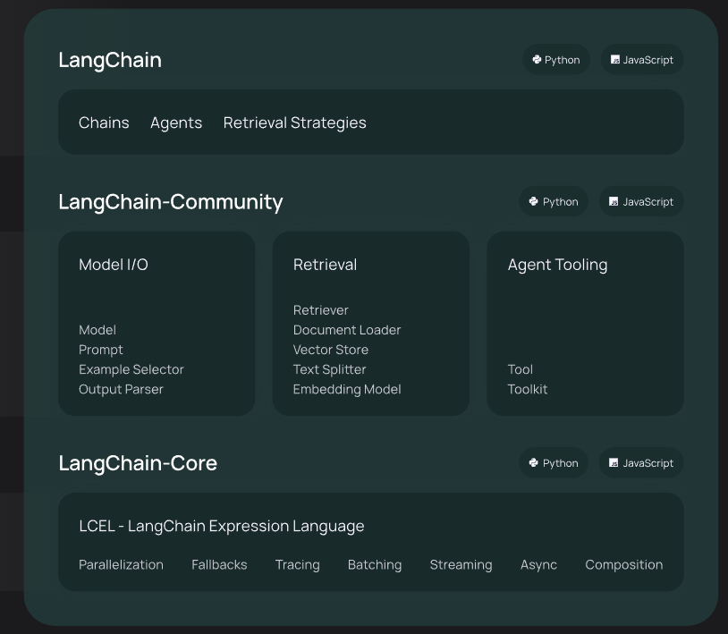


Nestling Main Features
Compare AI - properties comparison analysis
Our AI analyzes the features and characteristics of 2 properties to determine how well they align with buyer’s needs and preferences.
Notes:
Nicole
Another feature is CompareAI. Nestling is able to analyze the features and characteristics of 2 different properties to determine how well they align with the buyers’ needs and preferences.
We used LangChain together with openAI to generate the comparison analysis.
For our application we used the Lanchain-community libraries to load our data to OpenAI.
In addition, we used Flask, a Python web framework, for the backend API to post content to the server and fetch data for display on the frontend User interface.

Slide 11
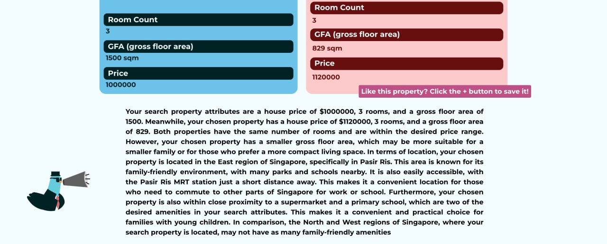
CompareAI output
Notes:
Nicole
When the user clicks on the Compare button this will be output of compare AI.

Slide 12
Language & APIs

Slide 13






Language Used
Vite
Python (py)
Cascading Style Sheets (CSS)
HyperText Markup Language (HTML)
Javascript (jsx)
React
Notes:
Nicole

Slide 14





APIs
Supabase API
OneMap API
Insert
Delete
Update your Database
Determine the required coordinates
URA API
OpenAI API
Past House Listing & Current House Listing
Artificial Intelligence Models for Comparing Listing
Flask Server API
Server to post and fetches data from backend to frontend
Notes:
Nicole

Slide 15
Documentations
Notes:
Abhijeet
Now we will be talking about Documentation.

Slide 16
Main Functional Requirements
01
Allows user to select their desired property attributes and save them to search for their properties later on. Users will know the valuation of the desired property and tune their choices accordingly.
Desired Property Function
02
Property Recommendations
Users can choose their properties listed from URA API based on the percentage match of the selected attributes and current listing properties in the database
03
AI Comparison of properties
Users can compare properties using the AI text generator that is trained on the current property data
04
Saving favourite properties
Users can save their favourite properties for future use
Notes:
Abhijeet
We will be talking about the main functional requirements.
This platform enables users to customize property attributes, assess valuations, and adjust preferences accordingly. By leveraging the URA API, users can access listings matching their criteria and gauge property matches based on attribute similarity. Additionally, an AI text generator facilitates property comparison, while users can conveniently save favored listings for future reference.

Slide 17
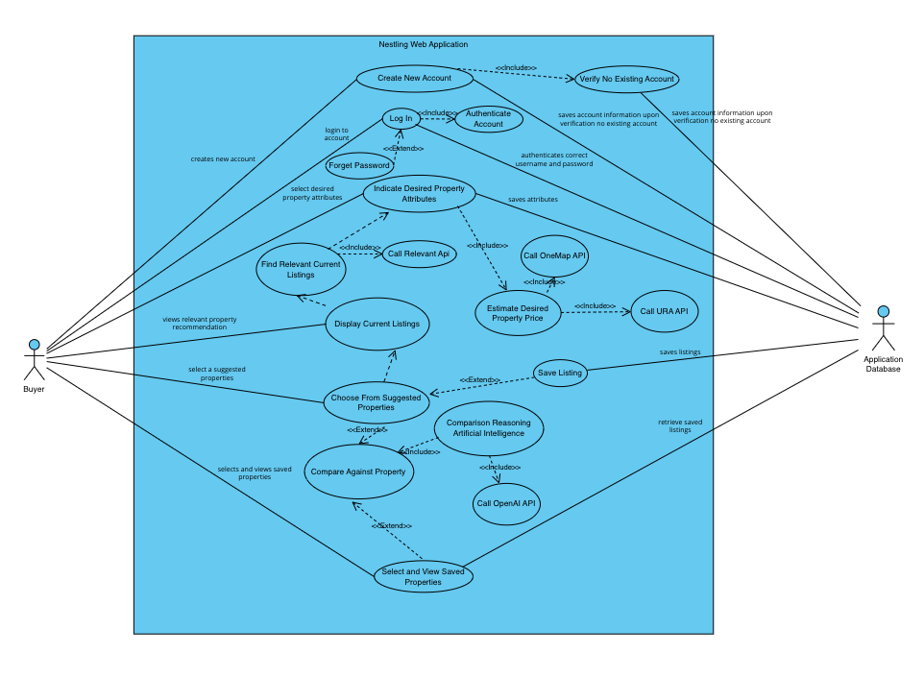
Use Case Diagram
Notes:
Abhijeet
Now, we will explain the six main use cases from our use case diagram. (Click)
Firstly, in this use case, a user must create an account to access our application. In this use case, upon the user entering their relevant details, it will be saved in the application database.(Click)
For the second main use case,the user attempts logs in to the application and authentication is achieved by the application database. If the user forgets their password, there is a password regeneration function.(Click)
The third use case, which is Indicate Desired Property Attributes, is where the user is able to provide their desired property attributes and obtain an estimated price. The desired property attributes can be saved in the application database.(Click)
The next main use case is the Display Current Listings, where current listings details are obtained from the application database and then displays on the web application.(Click)
After which, we can move on to the next use case where a user can select a suggested listing to view further details on it. The user may also compare the suggested listing against each other. The user can also save a selected suggested listing.(Click)
The last use case is where the user can view the properties that they have saved and compare them against each other.
The two use cases that we are going in depth for this presentation is the Create New Account and Display Current Listing use cases.

Slide 18
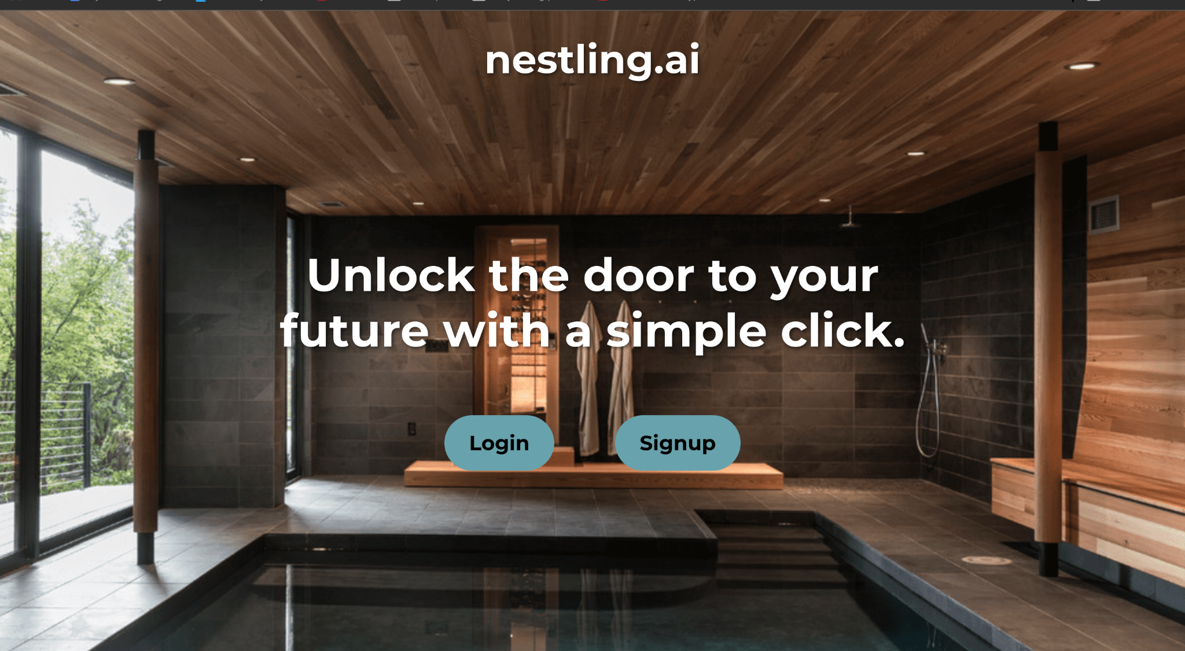
Use Case 1: Create New Account
Notes:
Abhijeet
For the use case, Create New Account, when a new user first opens the application, this is the landing page that the user would see. The user would then click on Signup. (Click)

Slide 19
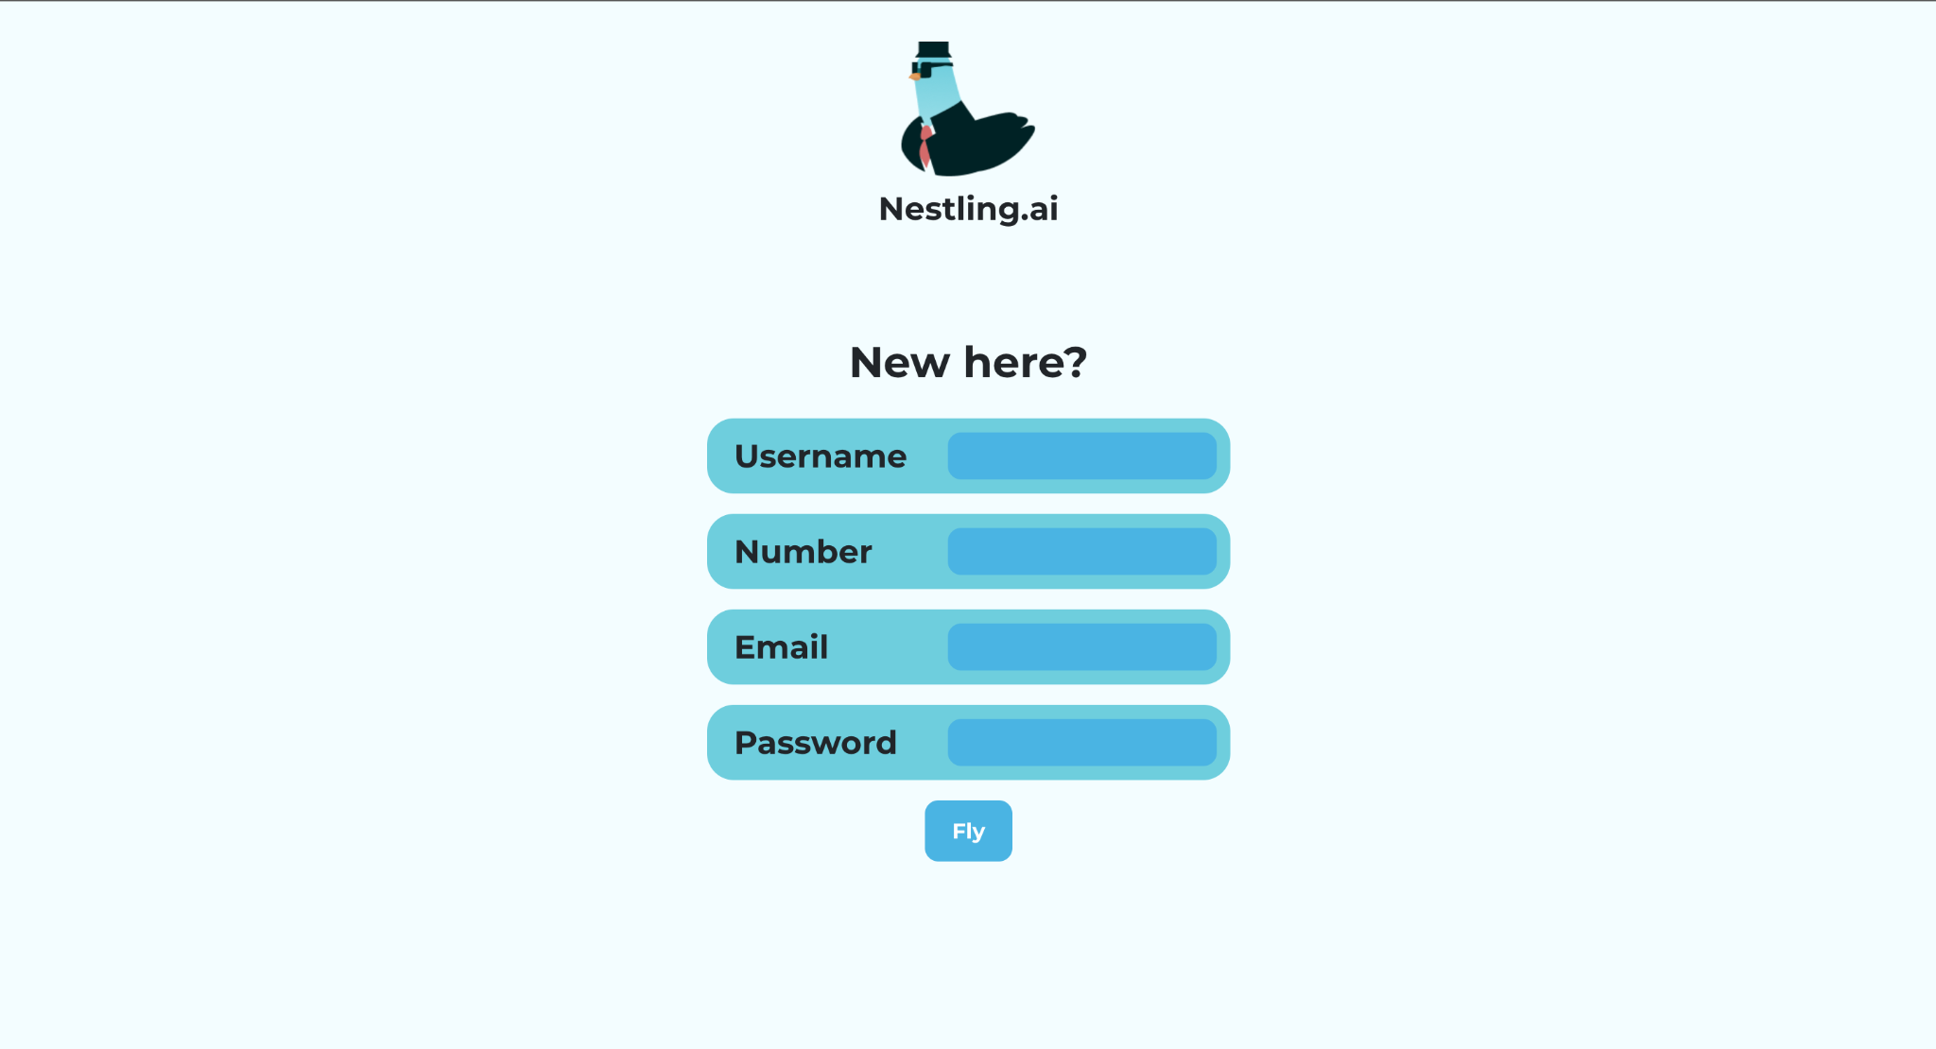
Use Case 1: Create New Account
Notes:
Abhijeet
After the user clicks on the Signup button, they would be able to populate the fields (Click) with their relevant information. After which, the user clicks on Fly (Click) and his new account would be saved in the application database.

Slide 20
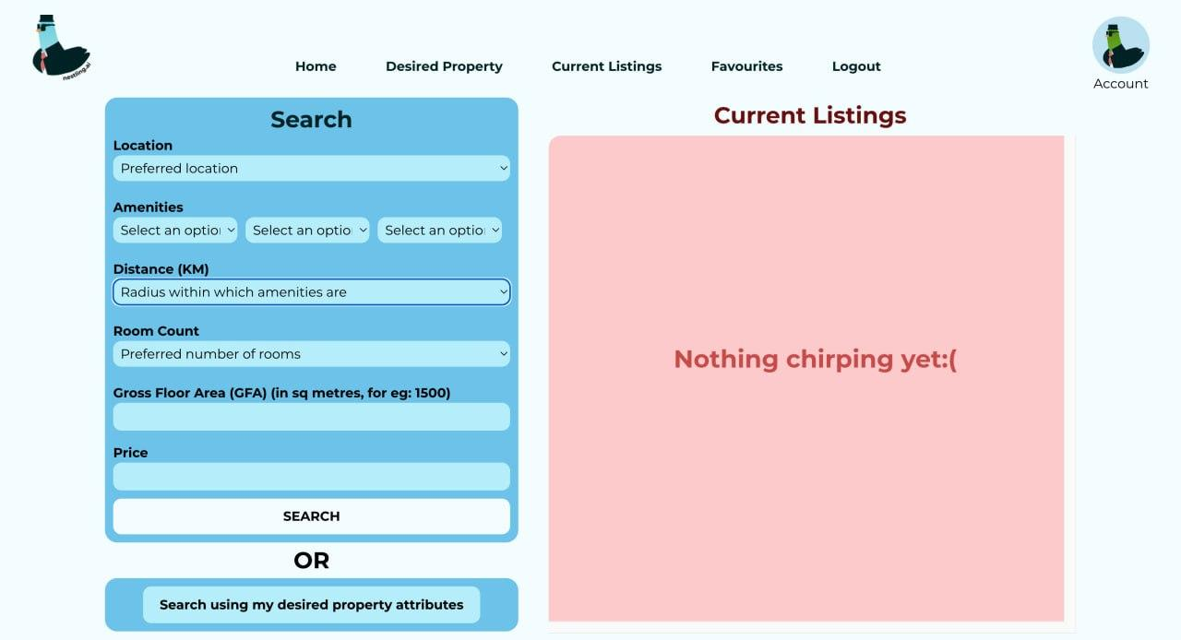
Use Case 2: Display Current Listings
Notes:
For our second use case, a user is able to search for a current property that is being listed by searching the application database, using the search function. The user is also able to search for current listings using their desired property attributes.

Slide 21
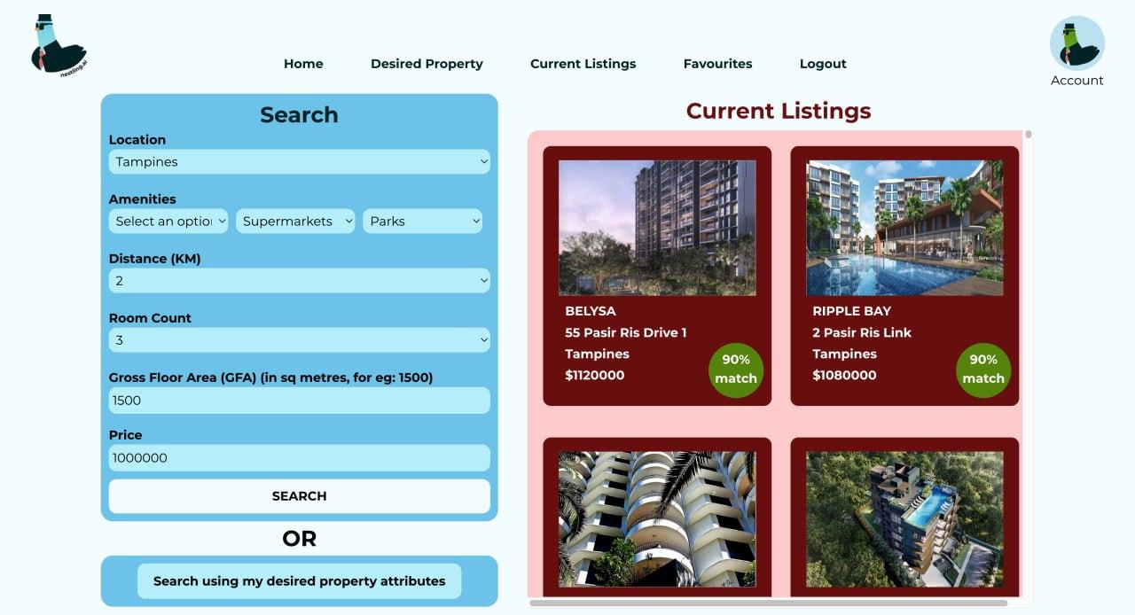
Use Case 2: Display Current Listings
Notes:
After clicking on search, this is what the page would look like where there are multiple properties that can be selected later. As you can see there are also percentage match indicators, where we have created an algorithm that gives you the percentage match that the current listing has to the search parameters.

Slide 22
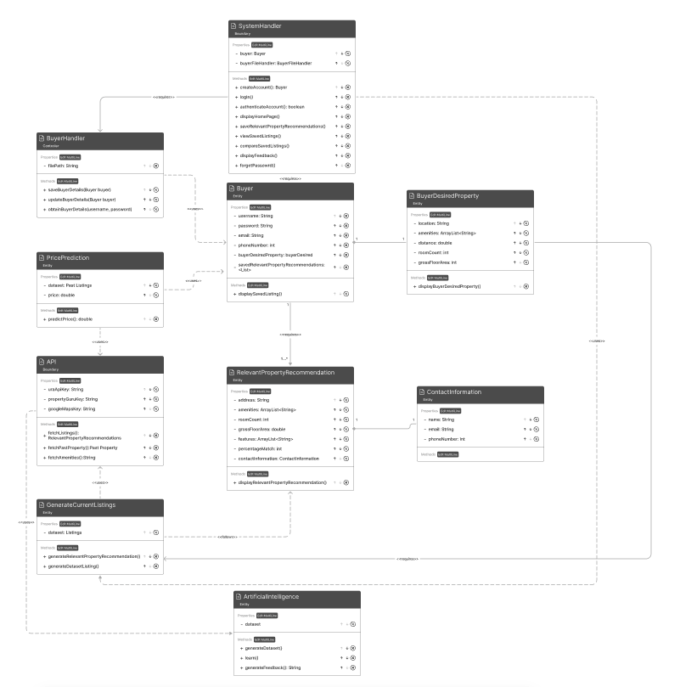
Class Diagrams
Notes:
This is the class diagram that we have made based on the use cases.

Slide 23
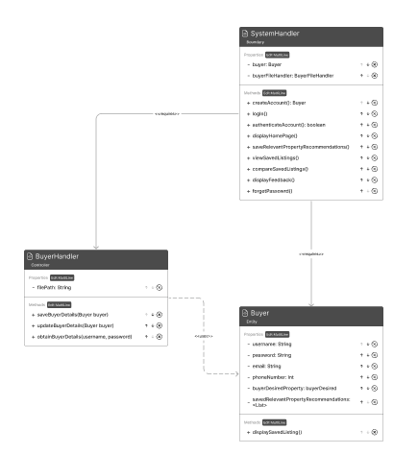
Use Case 1: Create New Account
Notes:
For the first use case, where a buyer signs up the SystemHandler Class would allow the user to create an Account using the createAccount() method. After inputting their details, the system handler would create a new buyer object.

Slide 24
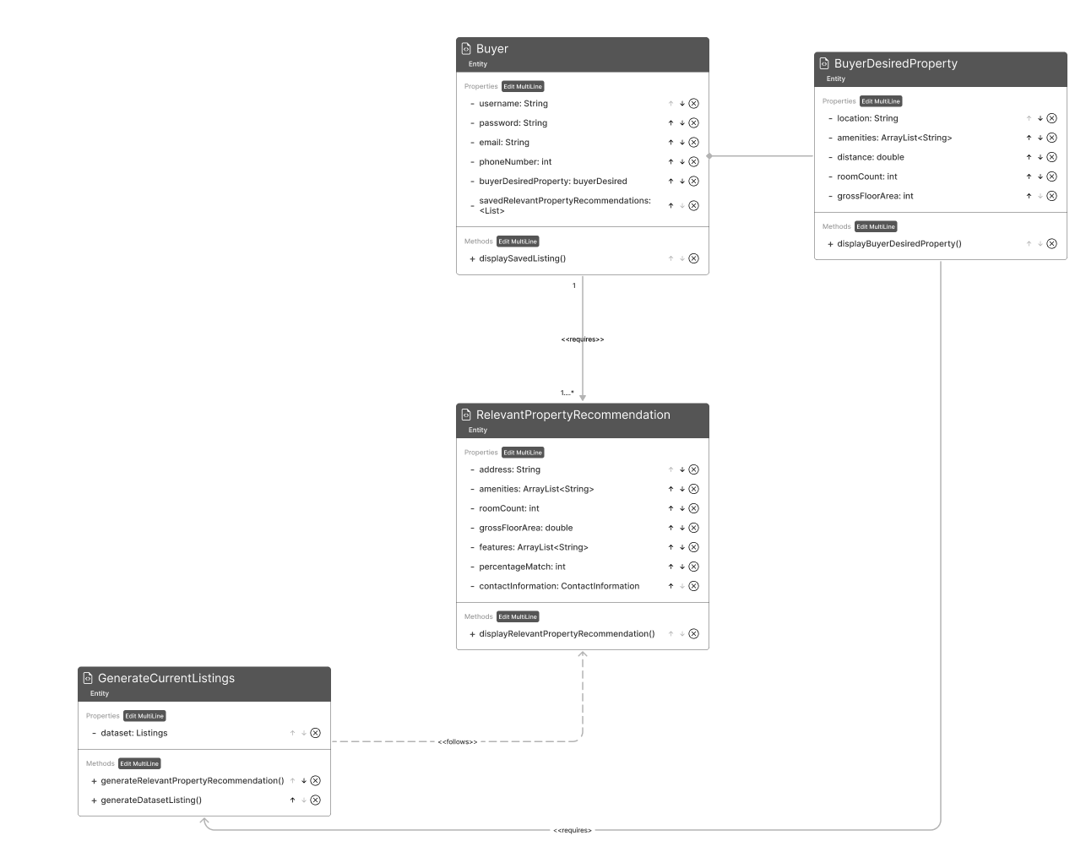
Use Case 2: Display Current Listings
Notes:
For the use case that displays current listings, these are relevant classes. The Buyer class is composed of the BuyerDesiredProperty class which contains the buyer’s desired property attributes. The GenerateCurrentListings class uses the the BuyerDesiredProperty class to generate a RelevantPropertyRecommendation object which can be saved in the form of a RelevantPropertyRecommendations arraylist with in a buyer object.

Slide 25
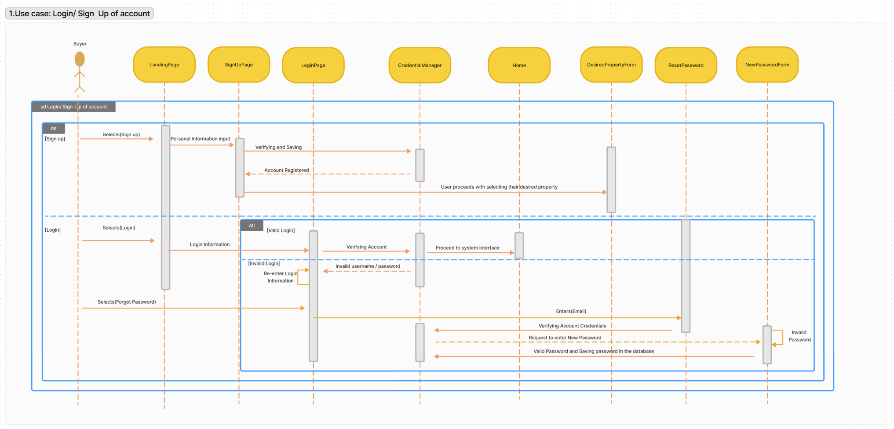
Sequence Diagram
Notes:
Nicole
Here is our sequence diagram for log in, sign up and reset password use case.

Slide 26
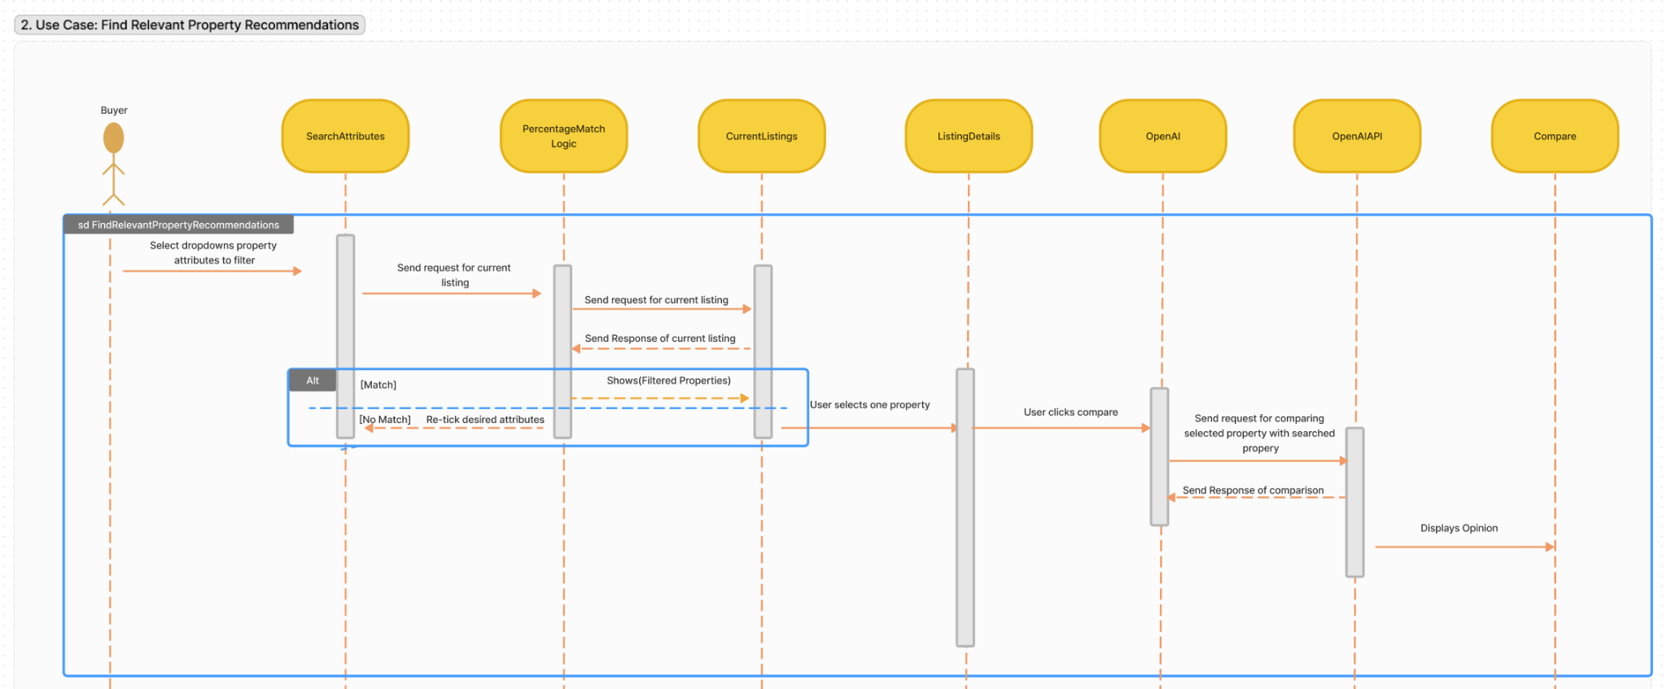
Sequence Diagram
Notes:
Nicole
Here is another sequence diagram for finding relevant property recommendation use case.

Slide 27
Traceability
Notes:
sharmilla

Slide 28
Blackbox Testing
Finding Relevant Property Recommendations: Gross Floor Area (sqm) [GFA]
Invalid Partition | Valid Partition | Invalid Partition
0 -1 -2 … | 1 2 … 4999 5000 | 5001 5002 5003 …
Equivalence
Class
Partitioning
Invalid Partition - Valid Partition lower boundary |  | Invalid Partition - Valid Partition Upper boundary
Boundary Value just below boundary | Boundary Value just above boundary | Boundary Value just below boundary | Boundary Value just above boundary
0 | 1 | 5000 | 5001
Boundary Value Testing
Notes:
Sharmilla
Next, I will talk about the blackbox testing we did on one control class which is Finding Relevant Properties -> based on Gross Floor Area
In equivalence class partitioning we partitioned the data based on your largest gross floor area and the minimum gross floor area a buyer can input
In boundary value testing, we partitioned the boundary which is 0, 1, 5000 and 5001 into invalid - valid lower boundary and upper boundary respectively.
With this, we can

Slide 29
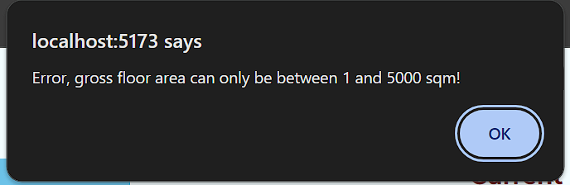
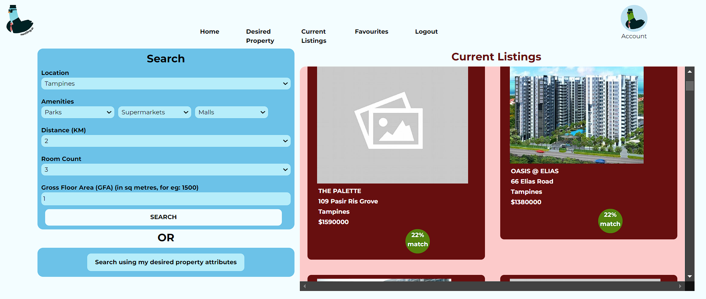
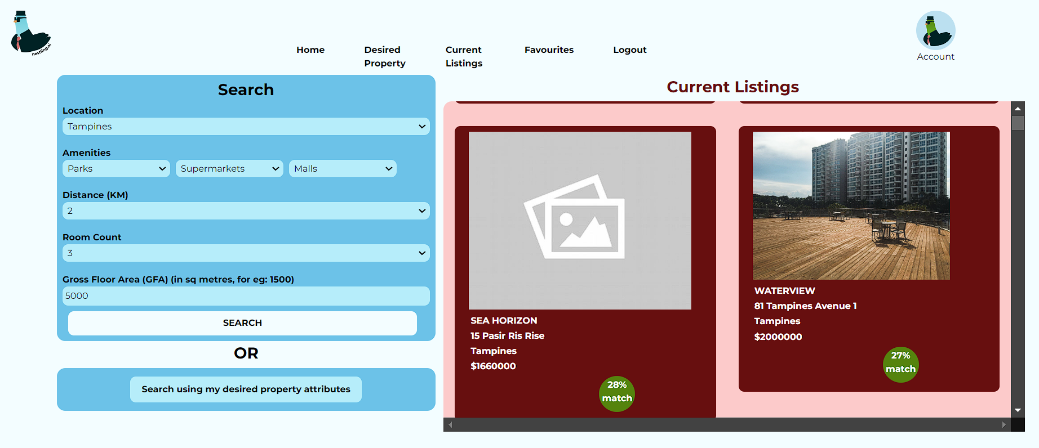
Blackbox Testing
Finding Relevant Property Recommendations: Gross Floor Area (sqm) [GFA]
Test Input | Expected Output | Actual Output
Input Gross Floor Area as 0 | Alert: Error, gross floor area can only be between 1 and 5000 sqm!
Input Gross Floor Area as 1 | Lists of matching properties are generated successfully
Input Gross Floor Area as 5000 | Lists of matching properties are generated successfully
Input Gross Floor Area as 5001 | Alert: Error, gross floor area can only be between 1 and 5000 sqm!
Notes:
Sharmilla
We can move on to the test input, expected output and the actual output from your web application.
If the buyer inputs the GFA as 0 or 5001 which is in the invalid range, the application will issue an alert for buyers to input only 1-5000
If the user inputs any number in the range 1-5000, then the properties matching the buyer’s input will be generated successfully

Slide 30
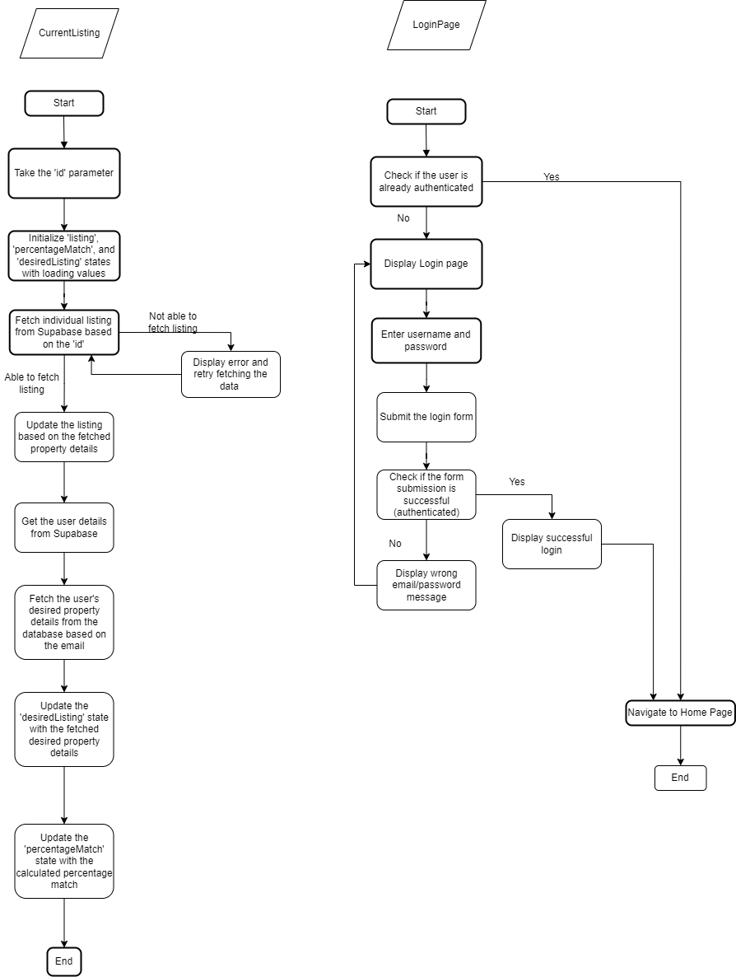
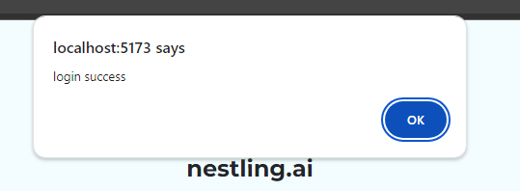
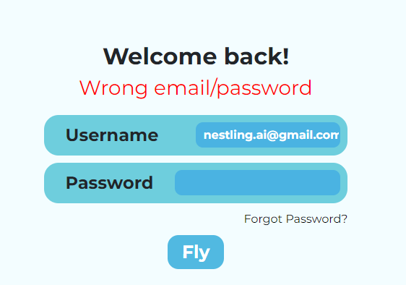
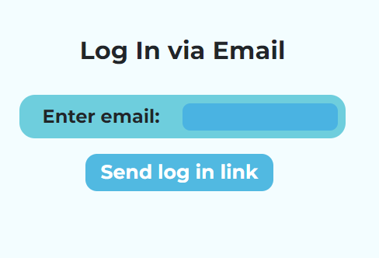
White-box testing
LoginPage
Test Input | Expected Output | Actual Output
The user is authenticated (Successful) | Directed to the Homepage | Directed to the Homepage
The user is not authenticated (Unsuccessful) | Directed to Login Page | Directed to Login Page
Input Validation Valid Input and Password | Directed to the Homepage after displaying ‘Login Success’
Input Validation Invalid Input and/or Password | Directed to Login Page
Clicked ‘Forget Password’ to reset password | Directed to enter email to send verification email to user. Then, user will be able to reset password after clicking the link that redirects to the Password Reset Page
Notes:
Sharmilla
Next we will move on to the white box testing, in the flow chart there is two functions, one is current listing and the other one is the login page, so the test cases here is based on the LoginPage function only
The flowchart was created based on the source code.
So, the user will not be authenticated if he inputs a invalid username or password.
User can also click Forget password to reset password where the user inputs their registered acc email and then the user can view the email for the details for the to reset password which will bring them back to the reset password page in your web application

Slide 31
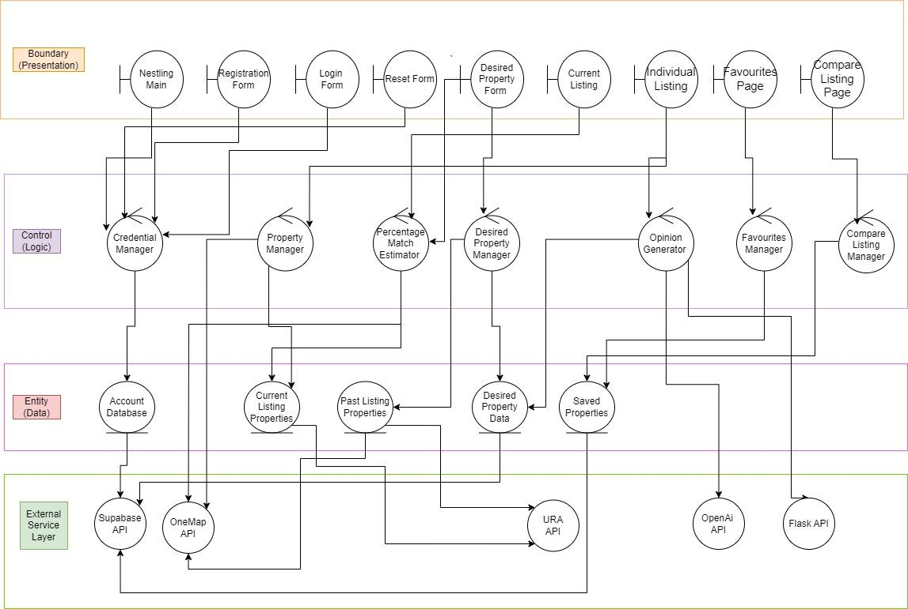
System Architecture
Notes:
Sharmilla
Here is our system architecture, where we have the boundary such as Nestling Main, registration form login form and so on which interacts with our buyers and our frontend interface.
Next, we have the control classes which performs logic such as verifying buyer’s acc under Credential Manager
Thirdly, we have Entity classes which stores our data which is fetched from the external service layer which is your APIs

Slide 32
Good Practices

Slide 33
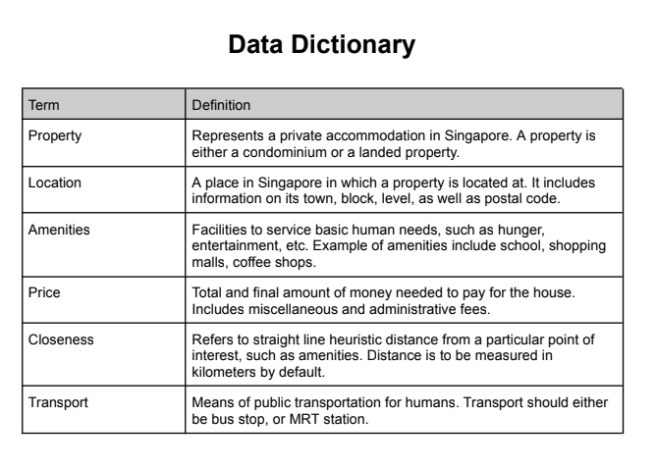
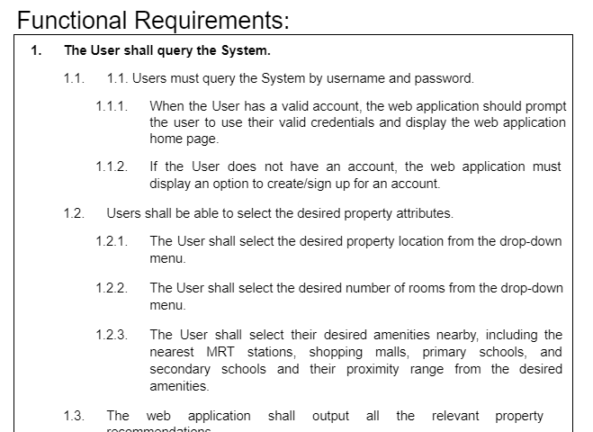
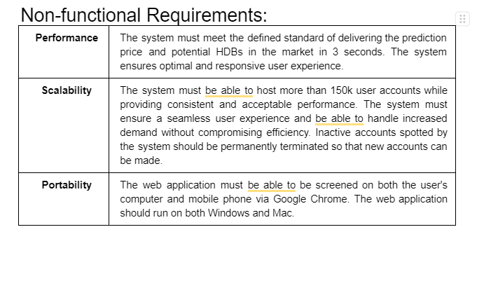
Good Practices
Requirements Elicitation
Functional Requirements
Non-Functional Requirements
Data Dictionary
Requirements Specification
Design
Implementation
Testing
Maintenance
Notes:
Pranavi

Slide 34
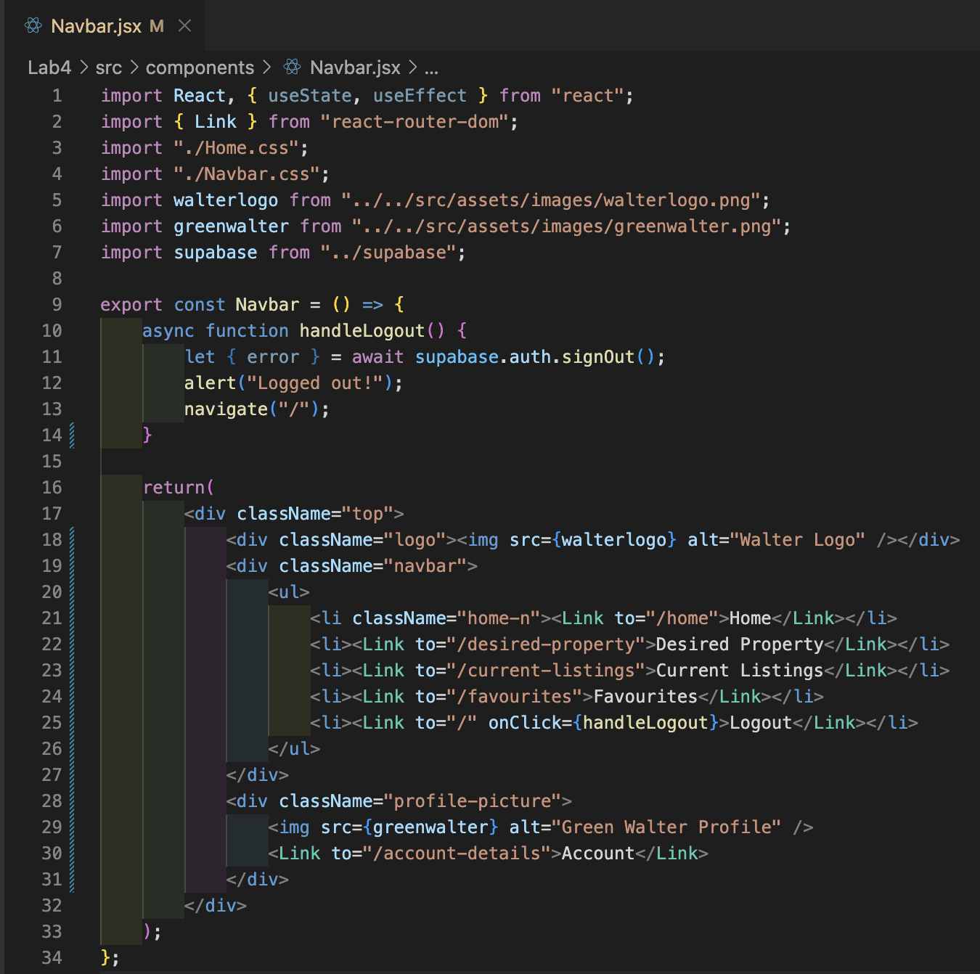
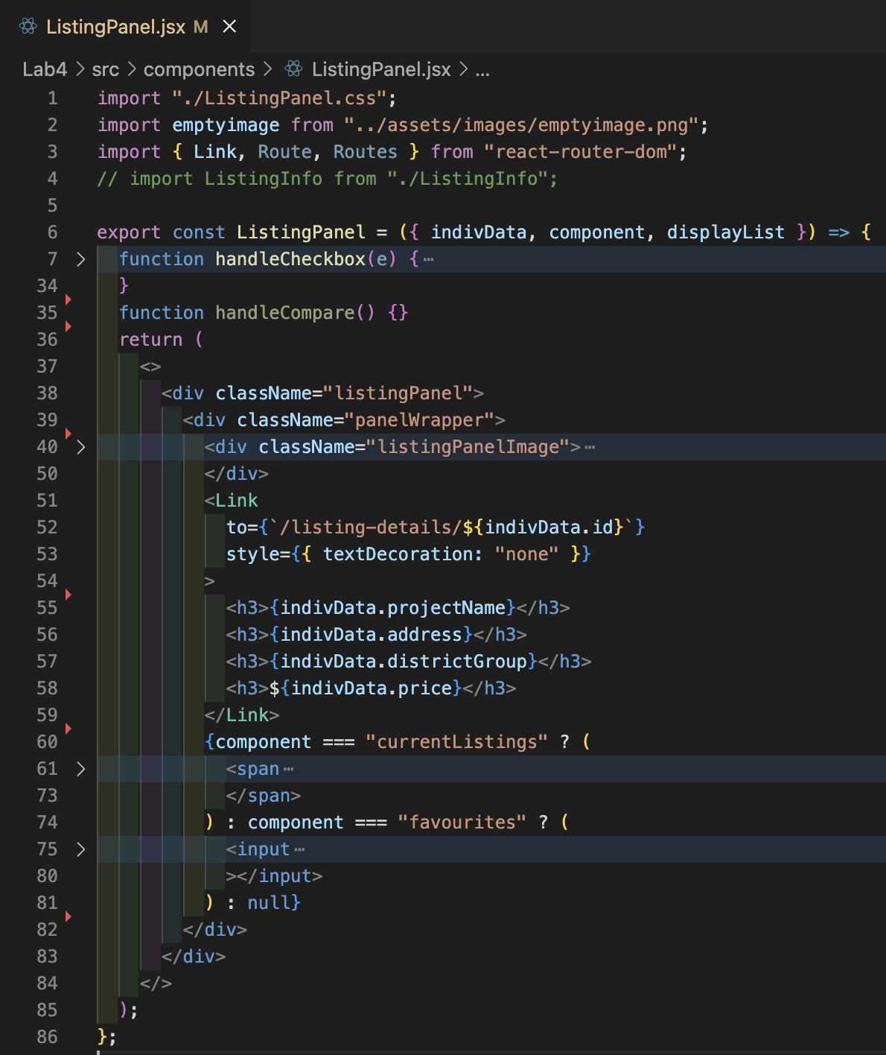
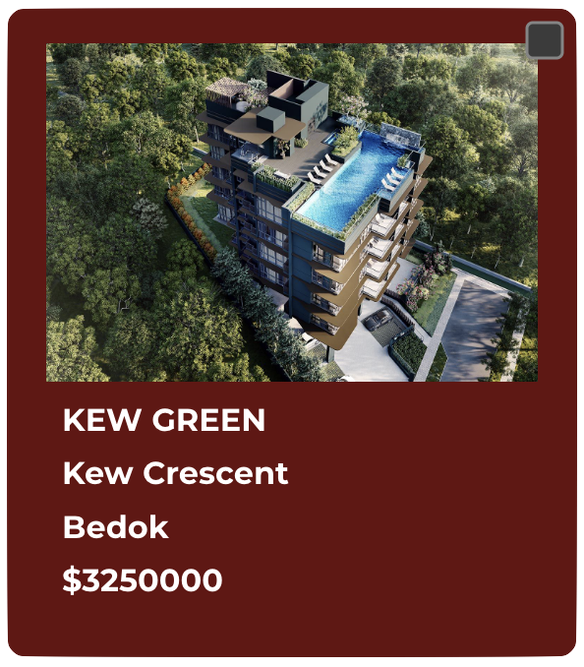
Good Practices
OOP Design Patterns
Abstraction
Navbar.jsx
ListingPanel.jsx
Requirements Specification
Design
Implementation
Testing
Maintenance
Notes:
Pranavi

Slide 35
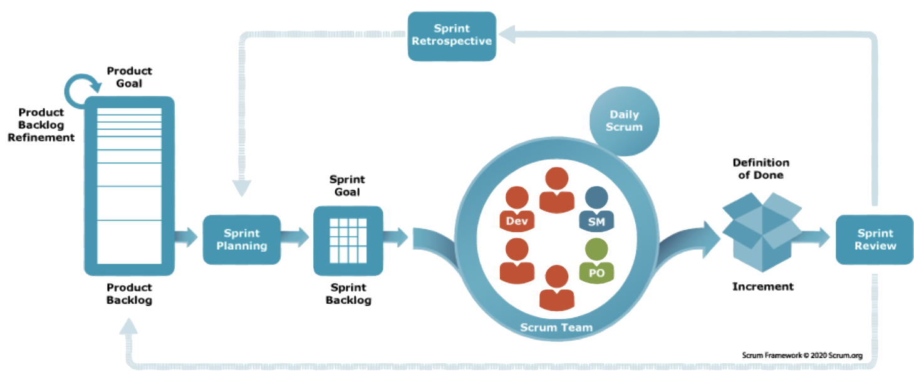
Good Practices
Agile Development Framework
SCRUM
Weekly stand-ups to measure progress iterative
Sprints review to check whether backlog/goals are reached
Requirements Specification
Design
Implementation
Testing
Maintenance
Notes:
Pranavi

Slide 36
Good Practices
Extreme Programming (Agile):
Pair Programming: front-end and back-end pairs
Incremental Delivery: small scale increments in implementation to facilitate testing
Requirements Specification
Design
Implementation
Testing
Maintenance
Notes:
Pranavi

Slide 37
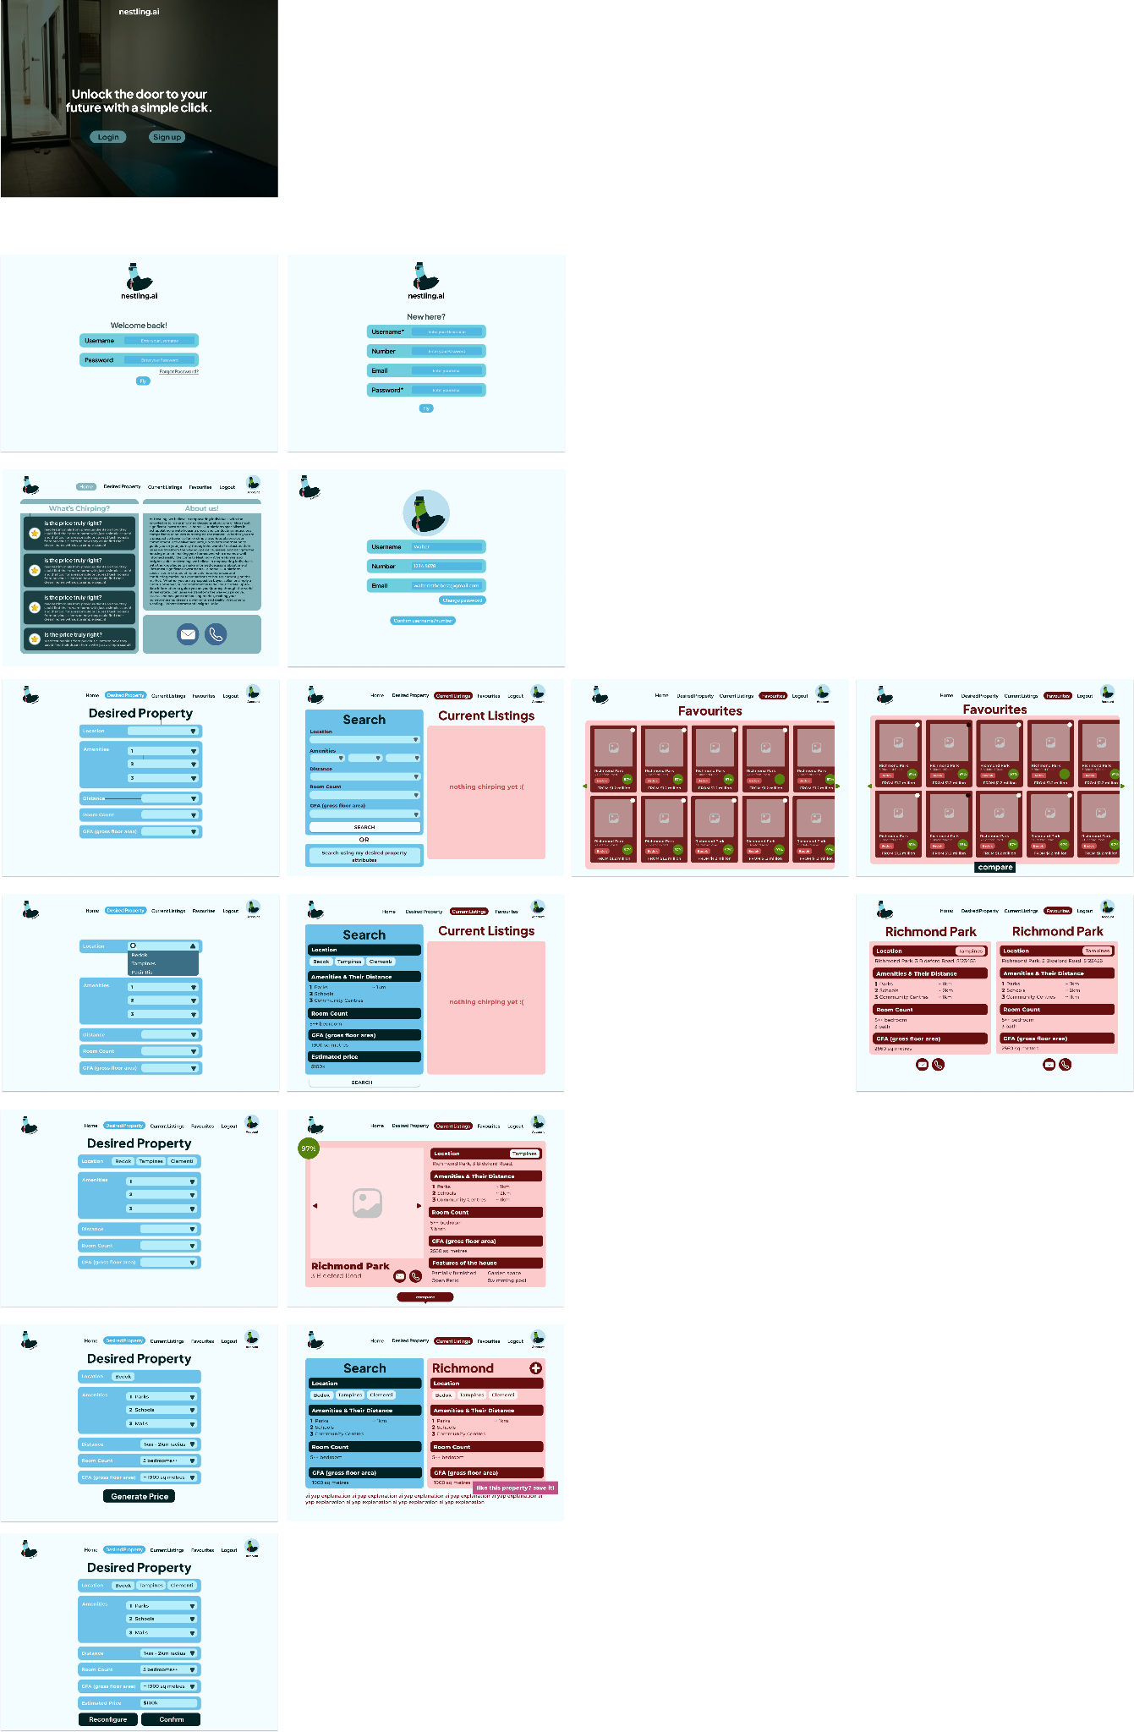
Good Practices
Requirements Specification
Design
Implementation
Testing
Maintenance
Notes:
Pranavi

Slide 38
Good Practices
Testing and Maintenance:
Whitebox and Blackbox testing
Blackbox: checks the accuracy of your system without too much concern about the internal implementations
Whitebox: scrutinises and analyzes your system by checking its internal coding
Requirements Specification
Design
Implementation
Testing
Maintenance
Notes:
Pranavi

Slide 39
Live Demo

Slide 40
Thank You!
Presented by: SCSD4

